Slide 1
TEAM One
Isaac, Ryan, Rui Jing

Slide 2
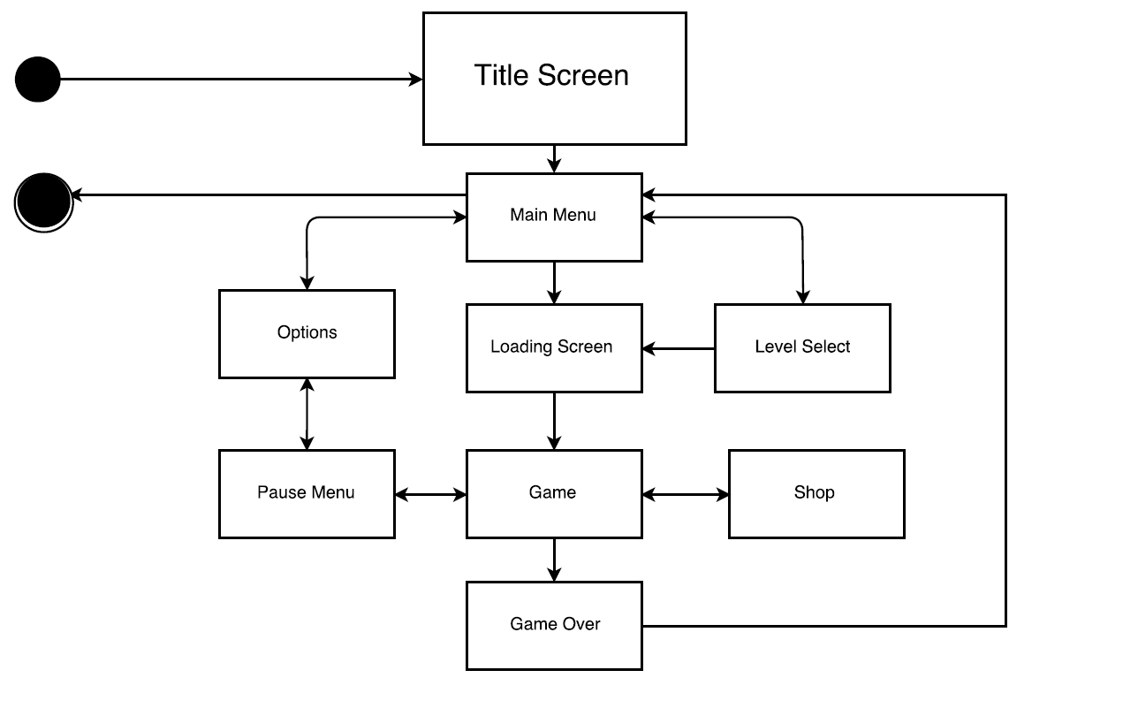
UML Diagram

Slide 3

Splash Screen

Slide 4

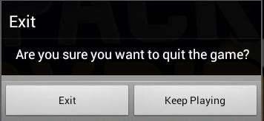
Main Menu

Slide 5
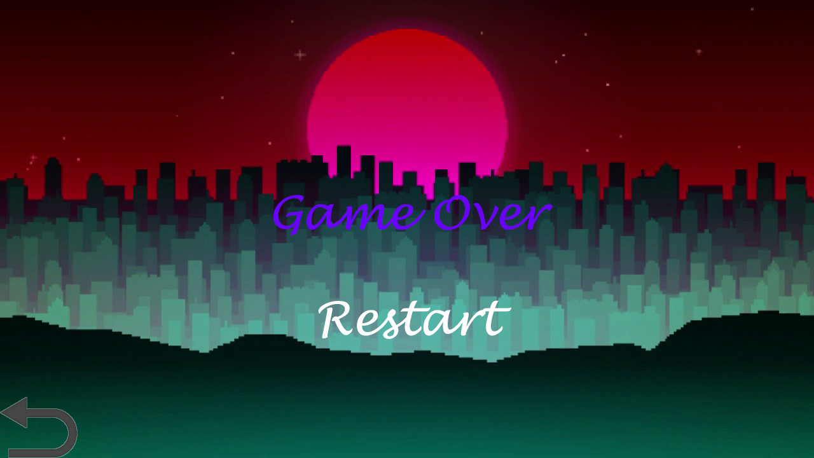
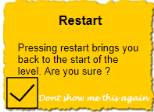
Game Over

Slide 6
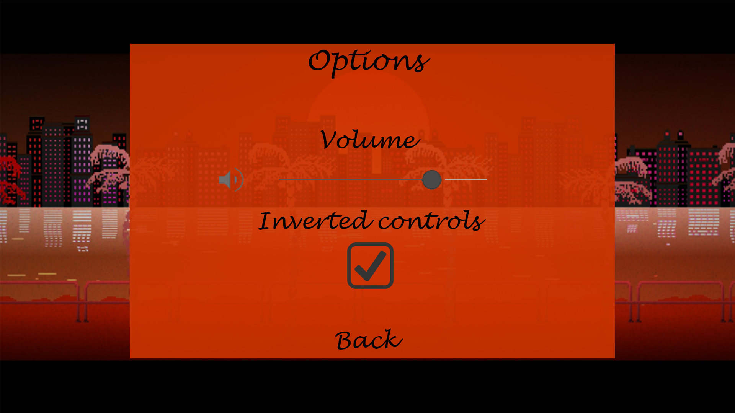
Options

Slide 7
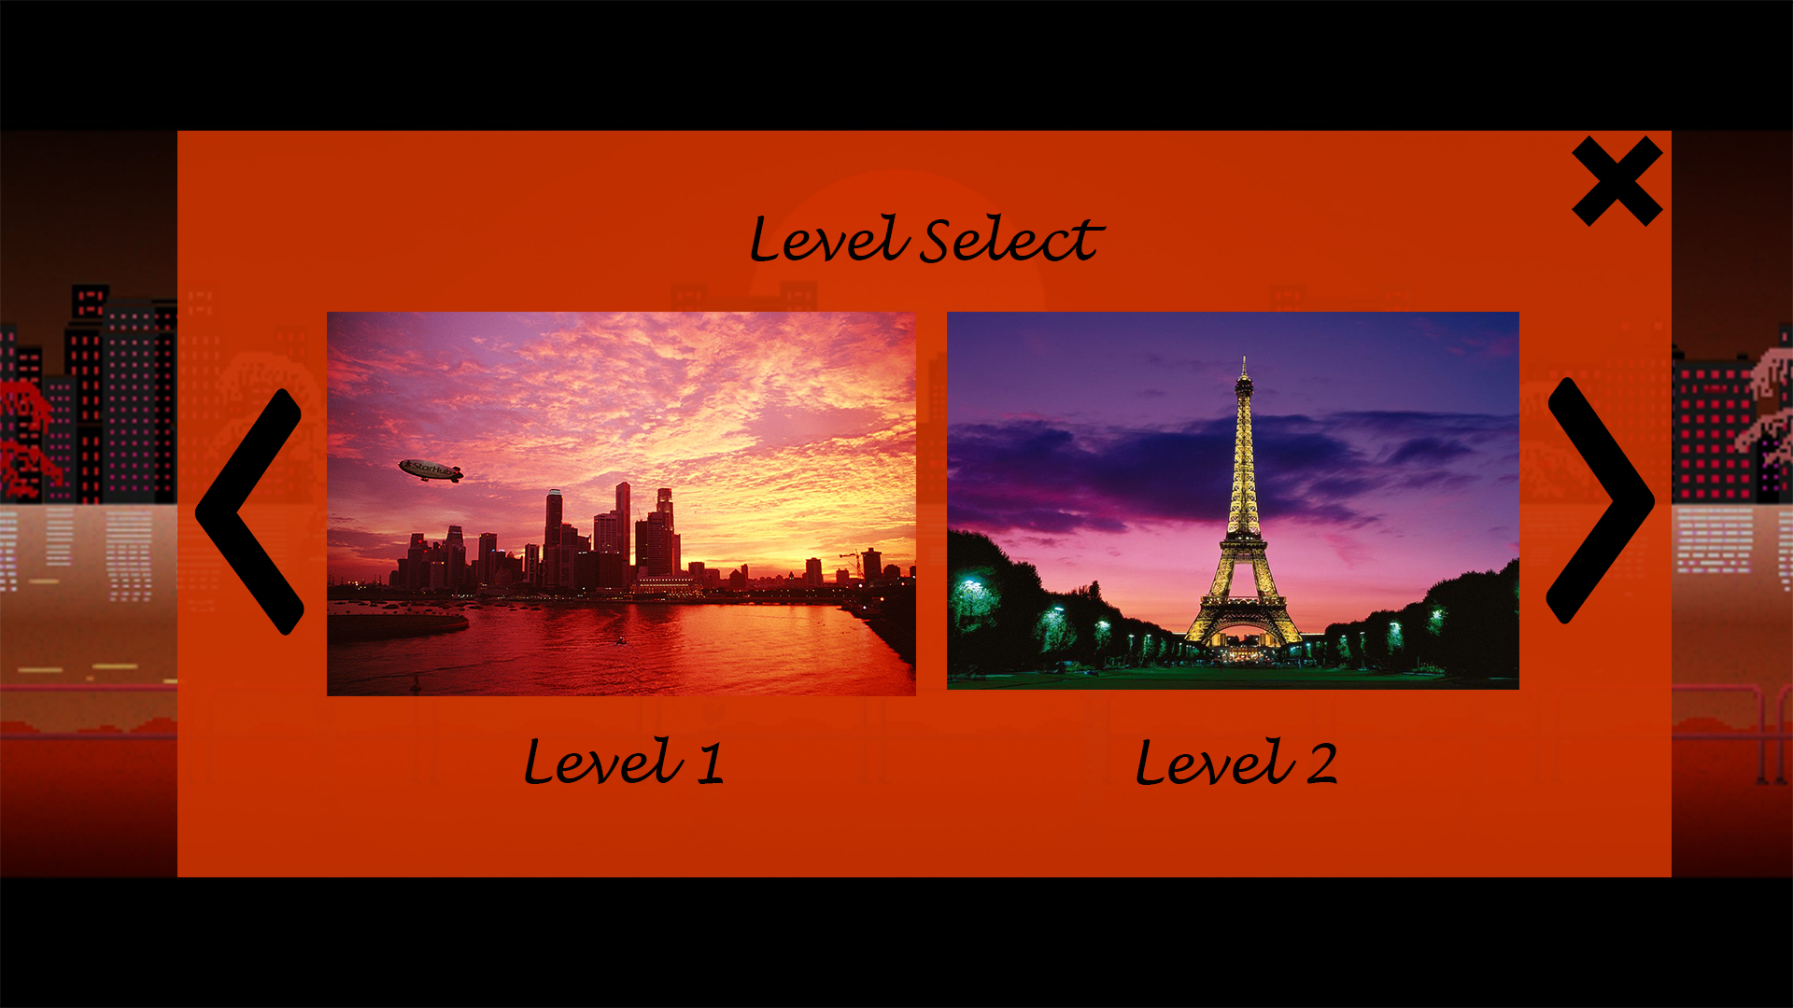
Level Select

Slide 8
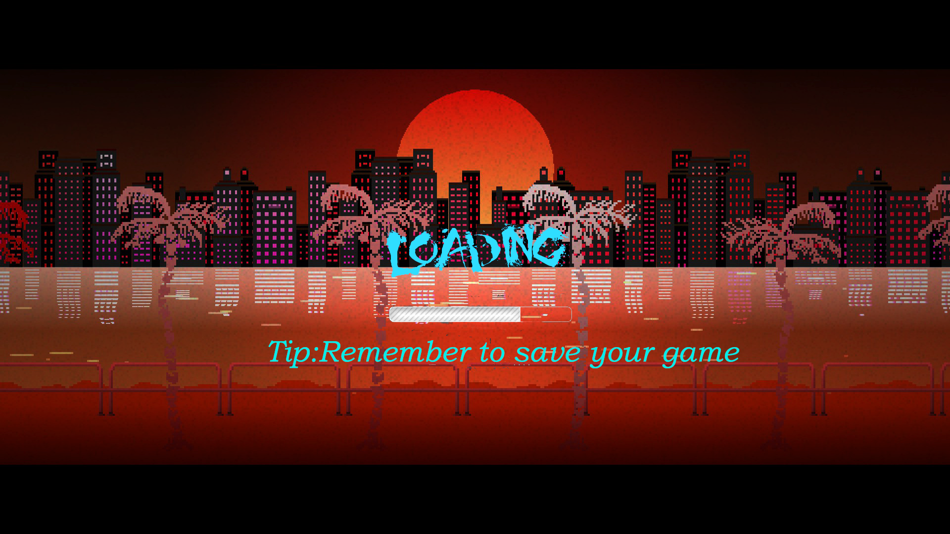
Loading Screen

Slide 9
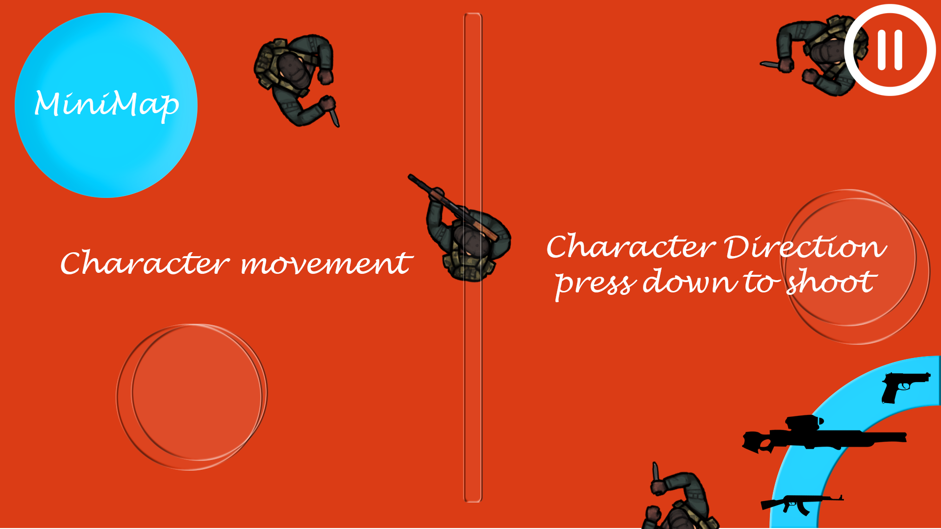
GamePlay

Slide 10
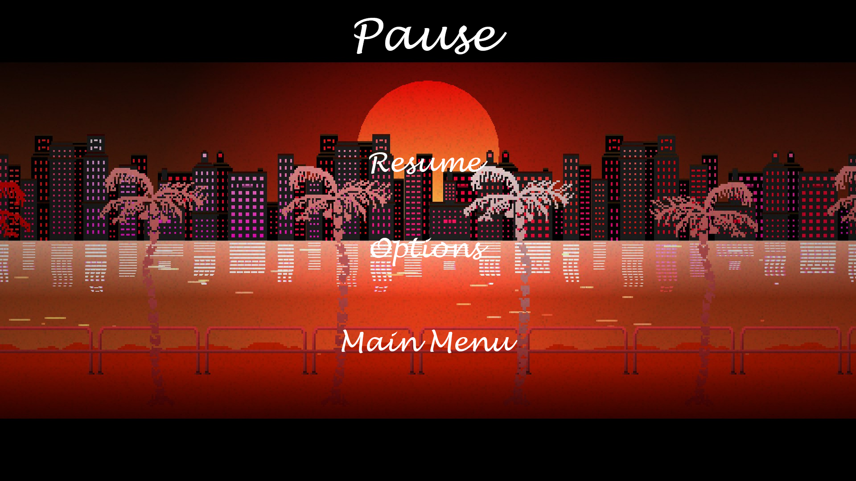
Pause Menu

Slide 11
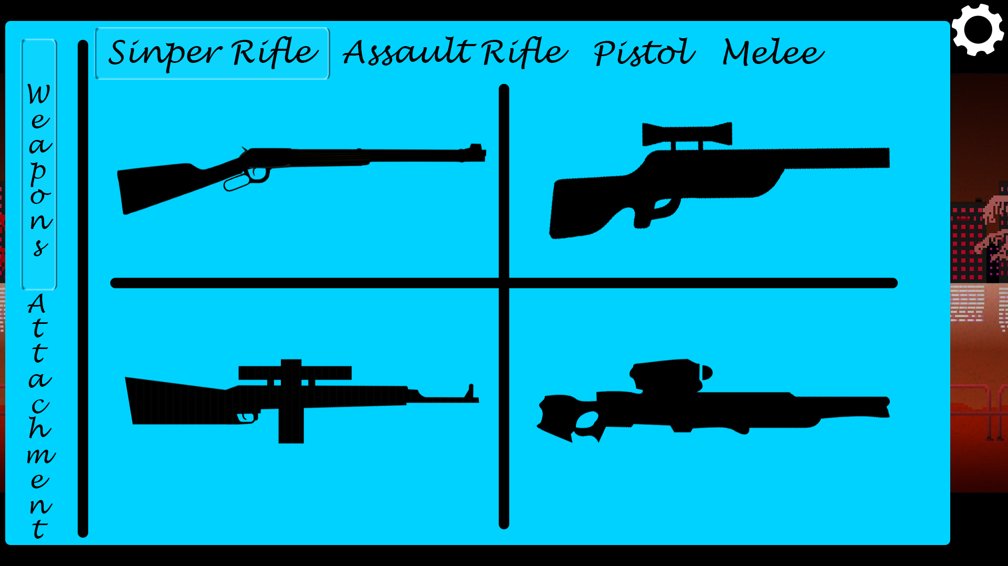
Shop

Slide 12
Technical Challenges
Gameplay Controls → The size needs to be the same size as a user's’ thumb
Background made the text hard to read, added a box to make it readable
Sometimes the user might not know if they are hovering on some of the buttons ,i made so that when the user hovers a button , it highlights white to prevent input errors. Buttons are also bigger to suit all user’s ergonomically needs.

